Slide 1
Competitive Programming
17 Nov. 2023
Andrei Novikov

Slide 2
Reverse Polish Notation
What kind of notation might be?
a b + - postfix – reverse polish notation;
a + b - infix – the natural way of writing math expressions;
+ a b - prefix – polish notation;

Slide 3
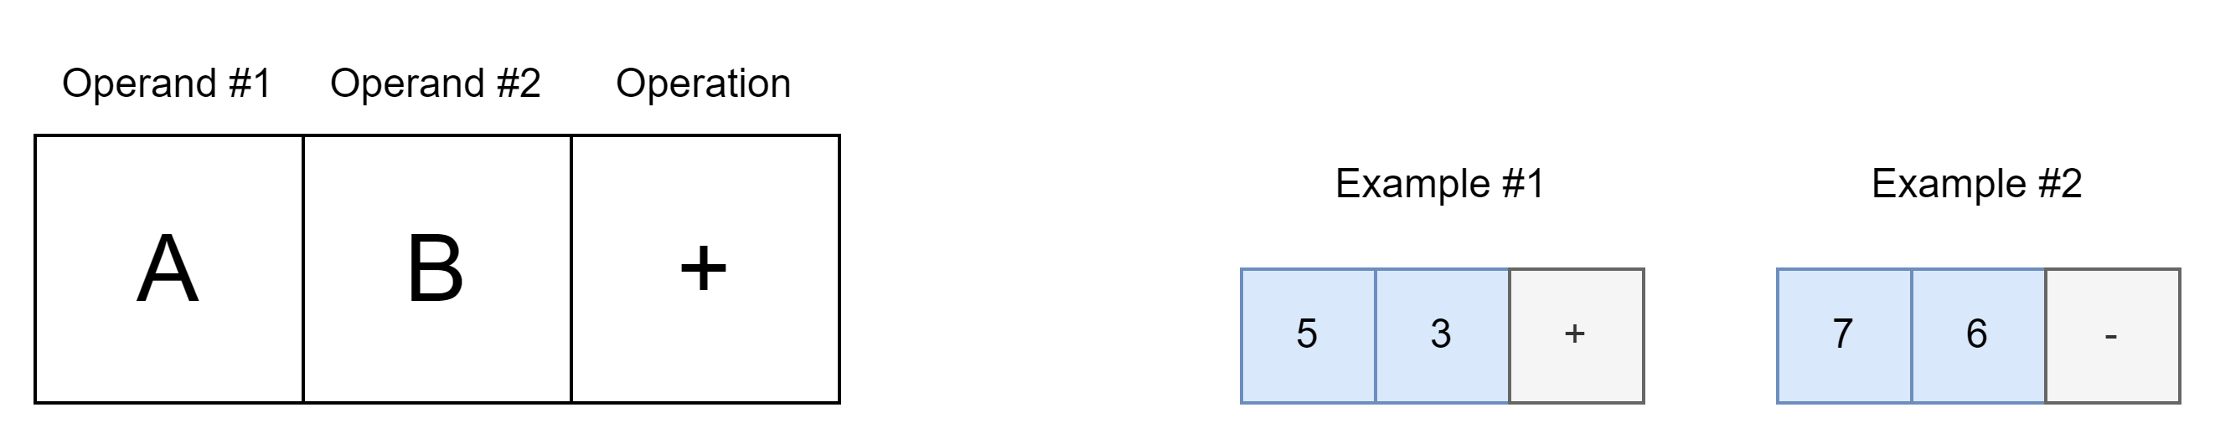
Reverse Polish Notation – Push to Stack
What kind of notation might be?
a b + - postfix – reverse polish notation;
a + b - infix – the natural way of writing math expressions;
+ a b - prefix – polish notation;

Slide 4
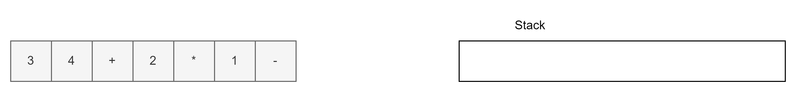
Reverse Polish Notation In Use

Slide 5
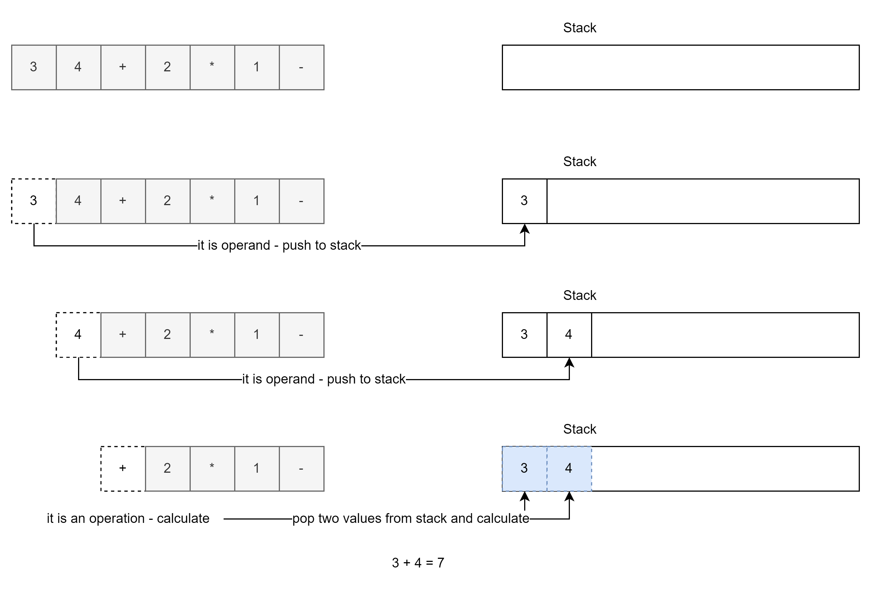
Reverse Polish Notation In Use
1
2
3
4

Slide 6
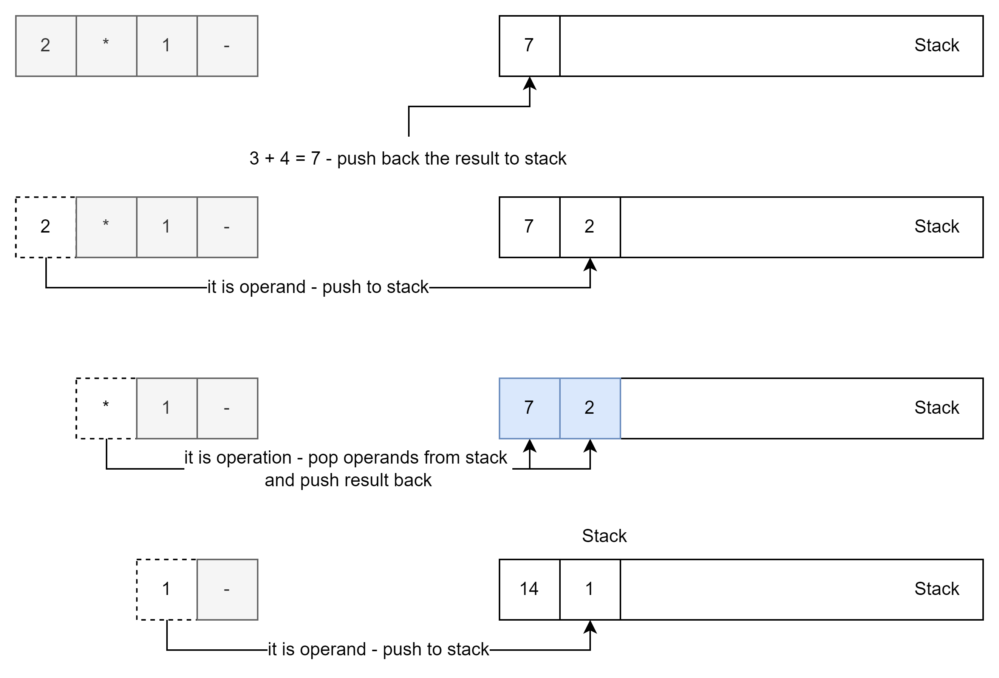
Reverse Polish Notation In Use
5
6
7
8

Slide 7
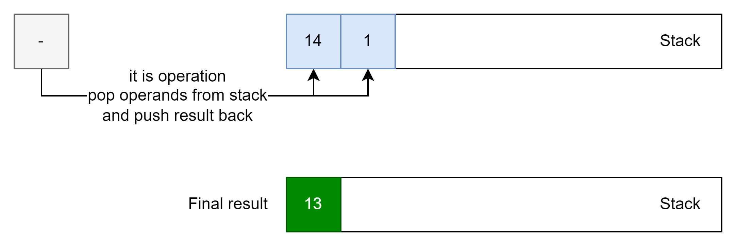
Reverse Polish Notation In Use
9
10

Slide 8
How to covert Infix to Postfix
Stack is used to covert infix to postfix. Example with A+B*C+D
Symbol | Stack | Postfix
A |  | A
+ | + | A
B |  | AB
* | +* | AB
C | +* | ABC
+ | +*+ * has higher priority than +, pop stack until empty or until operator with smaller priority
 | + push the current operator + to stack | ABC*+
D | + | ABC*+D
Empty | We are done, move everything from the stack to the string | AB*C+D+
If the precedence and associativity of the scanned operator are greater than the precedence and associativity of the operator in the stack [or the stack is empty or the stack contains a ‘(‘ ], then push it in the stack.

Slide 9

How to covert Infix to Postfix - Exercise
Open Excel table (or Calc in LibreOffice) and manually convert the following expression from infix to postfix using the approach before.
Input: ((A + B) – C * (D / E)) + F
Expected answer: AB+CDE/*-F+

Slide 10
Practice – Implement Expression Evaluator
Implement math expression evaluator using presented algorithms:
Infix to Postfix;
Reverse Polish Notation;
For simplification, consider operands is in [0, 9], in other words with size 1 to avoid write additional parse logic on top of these algorithms.

Slide 11
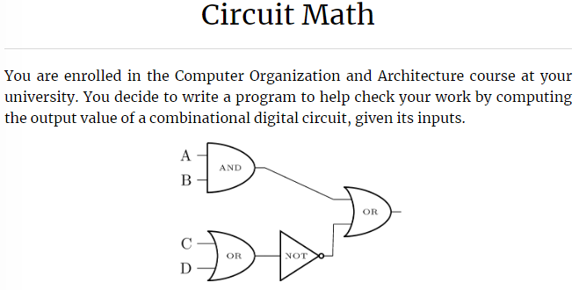
Practice – Postfix and RPN Problem
Kattis – Circuit Math:
Link to the Task;
If there is no time, consider it as a good homework to practice postfix and RPN algorithms.

Slide 12
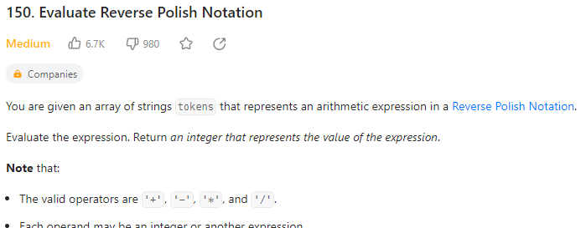
Homework
Leetcode – Evaluate Reverse Polish Notation
Link to the task

Slide 13
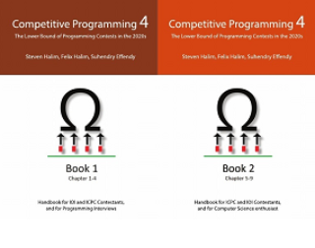
How to Learn and Practice
As one of the recommendation is to use:
Book Competitive Programming 4
Kattis – Link
Online Judge – Link
LeetCode - Link
Few Theory
A Lot of Practice
A Lot of Theory
Almost No Practice

